Slide 1
ATM Project
Josh Braegger
Melody Wheelwright
CS 3750 – April 24, 2007

Slide 2
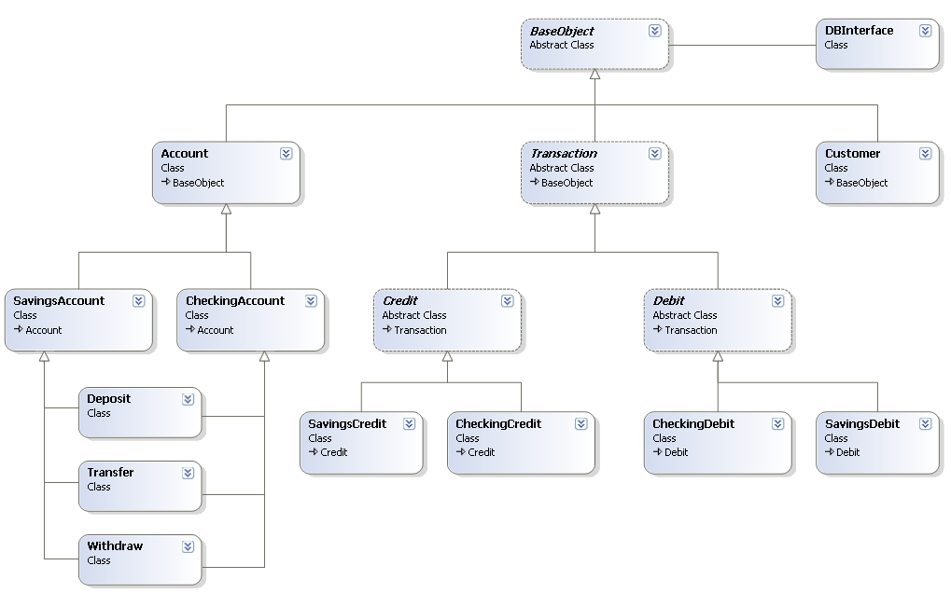
Design Class Diagram

Slide 3
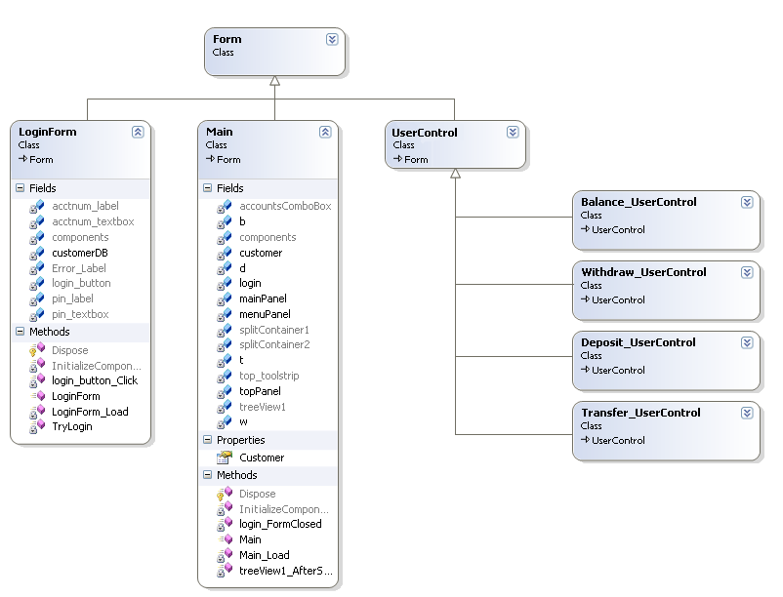
Forms

Slide 4
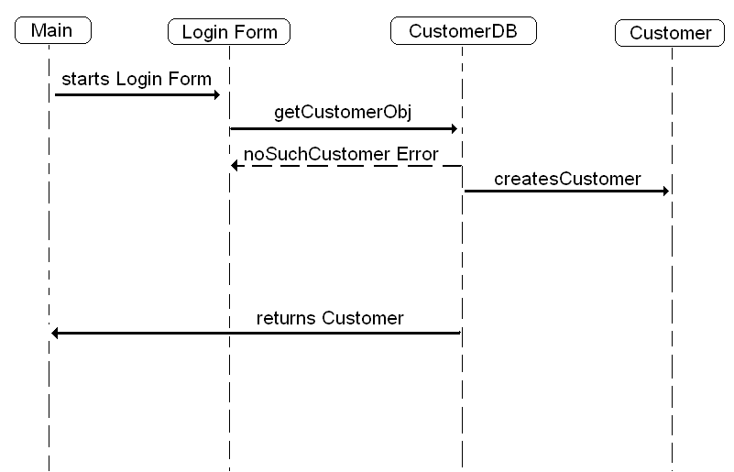
Login Sequence

Slide 5
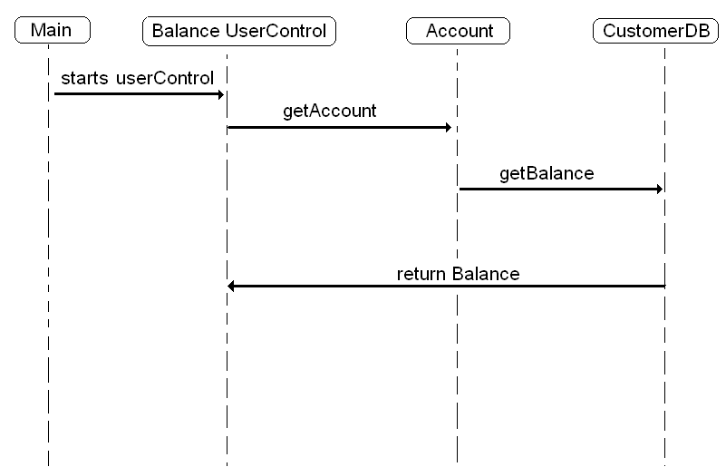
Account Balance Sequence

Slide 6
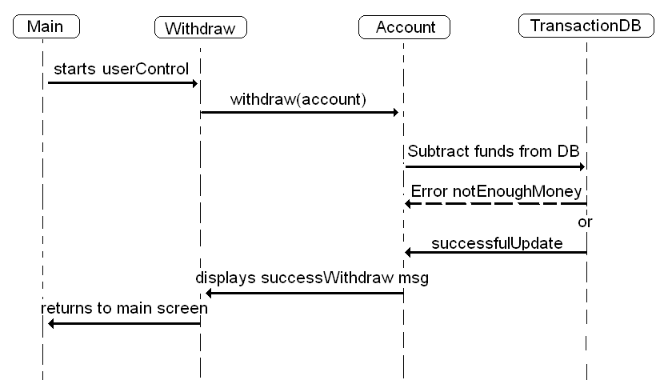
Withdraw Sequence

